Slide 1


Strategic Framework in Action:
STRATEGIC ENROLLMENT UPDATE
TIMOTHY L. KILLEEN
PRESIDENT
January 19, 2017

Slide 2

STRATEGIC FRAMEWORK PLEDGE
Best possible return on investment for our stakeholders
Efficient, competitive and constantly improving

Slide 3
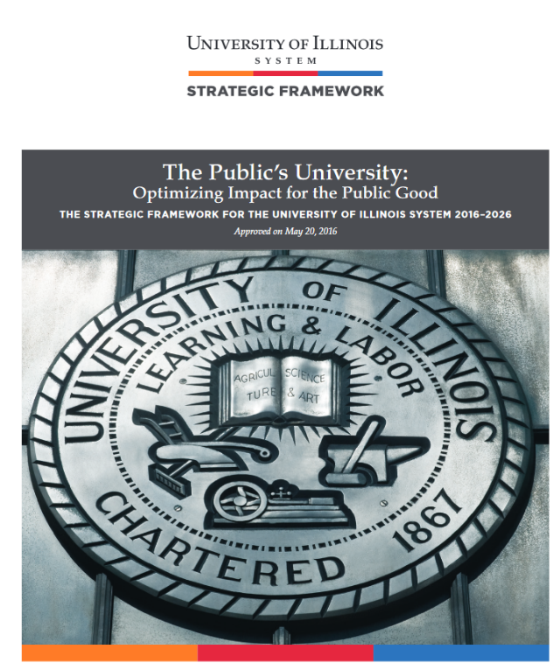
STRATEGIC FRAMEWORK PILLARS
An Institution of and for Our Students
Research and Scholarship with
Global Impact
A Healthy Future for Illinois and
the Midwest
Tomorrow’s University Today

Slide 4
ENROLLMENT HISTORY

Slide 5

THE CHANGING LANDSCAPE
Demographics
High school populations
First-generation students
Increasing diversity
Emerging pedagogies
Changing workforce needs

Slide 6
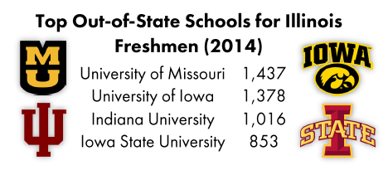
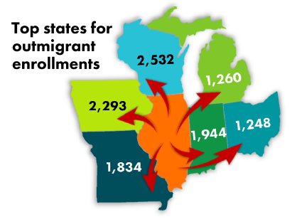
WHERE DO ILLINOIS HIGH SCHOOL STUDENTS GO?
Top States for Out-migrant Enrollments
H.S. Seniors
Source: IBHE

Slide 7

HOW DO WE BEST…
Serve Illinois
Transform lives
Meet demand
Expand excellence
Drive economic engine

Slide 8
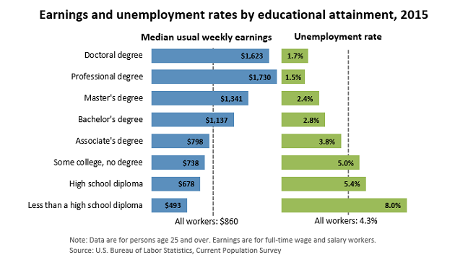
THE VALUE OF A DEGREE…

Slide 9

STRATEGIC ENROLLMENT
100,000
students?

Slide 10

STRATEGIC ENROLLMENT PLANNING PRINCIPLES
Maintain excellence
Opportunities for Illinois residents
Consistent with strategic goals
Capitalize on strengths
Ensure sufficient resources
Assess employment opportunities
Benchmark with peers

Slide 11

STRATEGIC PROCESS
STRATEGIES
FOR GROWTH
  New degree programs
  Expansion of existing programs
  Addition of program offerings

Slide 12

GROWTH STRATEGY: URBANA
Focuses on graduate and professional programs, with an emphasis on online programs

Slide 13

GROWTH STRATEGY: CHICAGO
Majority of growth is planned in undergraduate programs
Increase existing programs, expand 18 programs, and invest in five new programs

Slide 14
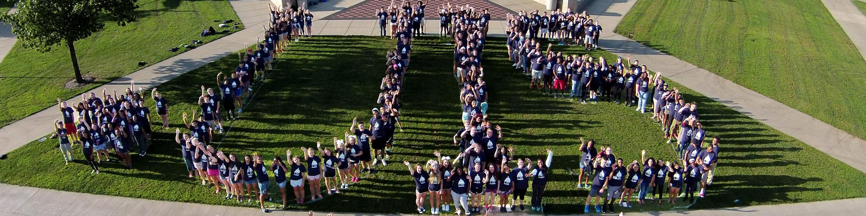
GROWTH STRATEGY: SPRINGFIELD
Increase the number of degree programs offered
Increase recruiting efforts in downstate Illinois
Expand online offerings

Slide 15
ENROLLMENT PROJECTIONS

Slide 16
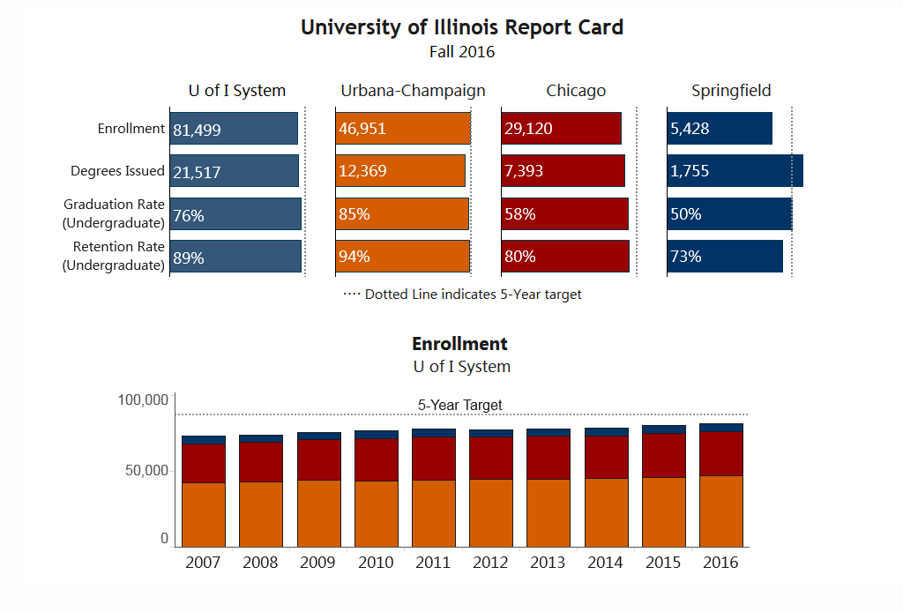
SYSTEM-WIDE PLAN
STRATEGIC
ENROLLMENT
PLAN:
93,646
NEARLY
15%

Slide 17

SUMMARY
Thoughtful planning
Intact
values
Vibrant future
Unique
opportunities
Poised for growth

Slide 18



